Slide 1

CS 481: Final Project Proposal
Group Name:
chadGPT
This Photo by Unknown author is licensed under CC BY-NC-ND.

Slide 2

SynapFlow
Team Members:
Jamison Coombs
Sean Perry
Edward Uriarte
Trevor Kvanvig
Bradley Tran

Slide 3

Reason to choose this Project
Difficult to study when phones are nearby, addicting and distracting.
Potential system and method for keeping our focus while working or studying.
Pomodoro technique is a proven way to study effectively.
Will be fun to see study progress.
Will be motivating to receive rewards for using app to work or study.

Slide 4

Potential Features
Focus Flow Timer
Achievement/Reward System
Task List System
Calendar System
Productivity Tracker/Data Analytics

Slide 5

Features cont.
Focus Flow timer
User sets timer for a period (Rec. 25 mins but user can adjust to suit their needs)
Additional Focus Capabilities:
Ability to turn of notifications
Ability to turn off Wi-Fi
Ability to turn off sound
App will know if you leave and slightly penalize user for leaving

Slide 6

Features cont.
Achievement/Reward system
If user successfully completes time without exiting, app will keep track
Achievement Award/Reward will be issued
If user is on a daily streak reward will be higher
If user does multiple sessions in a day rewards will be higher

Slide 7

Features cont.
Task List System
Can set and/or adjust priority hierarchy of each task
Users can apply settings such as reminders and deadlines for tasks created
Tasks can be grouped by categories
Ability to mark tasks as completed

Slide 8

Features cont.
Calendar System
User can look back at a calendar and see the progress they have made
Ability to fill calendar with events/tasks
Provides a clear and structured overview of tasks/events on a daily/weekly/monthly basis

Slide 9

Features cont.
Productivity Tracker/Data Analytics
App will track the number of focus sessions that a user has initiated and completed
Track the amount of time user spends for varying tasks
Tasks that occupy the most time will be adjusted to have the highest workflow priority to maximize productivity efficiency

Slide 10
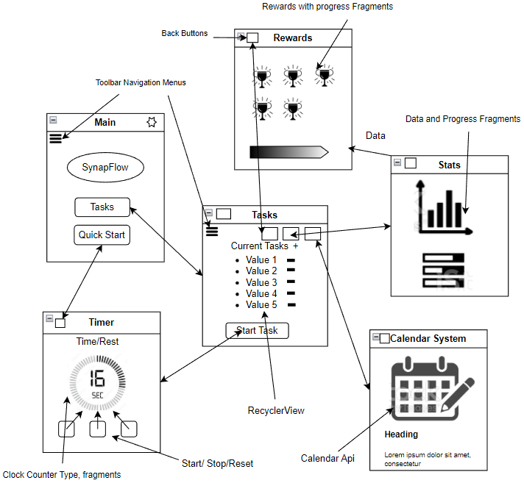
Navigation

Slide 11
Potential Kotlin Concepts
Set up timer functionality
Set up calendar functionality
Set up view to see stats
Set up Achievements/Rewards
Algorithm to determine User reward
Algorithm to calculate break time ( higher study/ work time will result in bigger break time)

Slide 12
Any Questions???

